Slide 1


Онлайн-образование

Slide 2
Меня хорошо видно && слышно?
Ставьте , если все хорошо
Напишите в чат, если есть проблемы
+

Slide 3
Тема:Разработка архитектуры сетей ЦОД с использованием VXLAN\EVPN с целью миграции серверного сегмента из сети с традиционной архитектурой
Ипатов Михаил Михайлович
Инженер 1 кат. ОИС
АО «Консист-ОС»

Slide 4

Цели проекта
Уход от классической tier-3 топологии в сегменте ЦОД
1
Разработка архитектуры сетей ЦОД с использованием VXLAN\EVPN
2
Миграция серверного сегмента на новую архитектуру
3

Slide 5

Что планировалось
1
Проектирование отказоустойчивой и масштабируемой 5-stage топологии Clos для двух ЦОД ( с возможностью масштабирования)
2
Проектирование DCI interconnection между площадками с помощью super-spine
Выделение фигурой/маркером инфы
3
Проектирование адресного пространства
4
Проектирование сетевых зон и взаимодействия между ними
Одна мысль на слайде
без картинок
Использование цифр для опроса
0-9
5
Проектирование DCI interconnection между ЦОД разных филиалов

Slide 6
Используемые технологии
1
OSPF – для построения IP-связанности внутри AS (Underlay)
Выделение фигурой/маркером инфы
2
BGP EVPN – для построения Overlay-сети L2 поверх L3 Underlay
3
VxLAN – для построения туннельной связанности между VTEP-устройствами и инкапсуляции L2 Ethernet в UDP-дейтаграмму (порт 4789) и L3-пакет.

Slide 7
Что получилось
Сетевые зоны
ЦОД ТАИ
Network | Gateway / Interface VLAN IP Address | VLAN ID | VLAN Name | VRF | VNI | Description
10.3.10.0/24 | 10.3.10.254 | 10 | 10-DataStorage | NET | 10010 | Сеть для размещения систем хранения
10.3.11.0/24 | 10.3.11.254 | 11 | 20-ТАИ | NET | 10011 | Сеть для размещения узлов ТАИ
10.3.20.0/24 | 10.3.20.254 | 20 | 30-Back+Front | NET | 10020 | Сеть для размещения узлов с веб-серверами
10.3.30.0/24 | 10.3.30.254 | 30 | 40-QA | NET | 10030 | Сеть тестирования

Slide 8
Что получилось
Сетевые зоны
ЦОД ОИС
Network | Gateway / Interface VLAN IP Address | VLAN ID | VLAN Name | VRF | VNI | Description
10.3.110.0/24 | 10.3.110.254 | 110 | 10-DataStorage | NET | 10110 | Сеть для размещения систем хранения
10.3.111.0/24 | 10.3.111.254 | 111 | 20-ТАИ | NET | 10111 | Сеть для размещения узлов ТАИ
10.3.120.0/24 | 10.3.120.254 | 120 | 30-Back+Front | NET | 10120 | Сеть для размещения узлов с веб-серверами
10.3.130.0/24 | 10.3.130.254 | 130 | 40-QA | NET | 10130 | Сеть тестирования

Slide 9
Настройка Оspf на примере ЦОД ТАИ
DC1_SpineL
interface Ethernet1
mtu 9120
no switchport
ip address 10.3.255.0/31
ip ospf network point-to-point
ip ospf area 0.0.0.0
interface Ethernet2
mtu 9120
no switchport
ip address 10.3.255.2/31
ip ospf network point-to-point
ip ospf area 0.0.0.0
interface Ethernet3
mtu 9120
no switchport
ip address 10.3.255.4/31
ip ospf network point-to-point
ip ospf area 0.0.0.0
interface Ethernet4
mtu 9120
no switchport
ip address 10.3.255.121/31
ip ospf network point-to-point
ip ospf area 0.0.0.0
interface Ethernet5
mtu 9120
no switchport
ip address 10.3.255.133/31
ip ospf network point-to-point
ip ospf area 0.0.0.0
router ospf 1
router-id 10.3.253.1
passive-interface default
no passive-interface Ethernet1
no passive-interface Ethernet2
no passive-interface Ethernet3
no passive-interface Ethernet4
no passive-interface Ethernet5
max-lsa 12000
DC1-SpineR
interface Ethernet1
mtu 9120
no switchport
ip address 10.3.255.14/31
ip ospf network point-to-point
ip ospf area 0.0.0.0
interface Ethernet2
mtu 9120
no switchport
ip address 10.3.255.16/31
ip ospf network point-to-point
ip ospf area 0.0.0.0
interface Ethernet3
mtu 9120
no switchport
ip address 10.3.255.18/31
ip ospf network point-to-point
ip ospf area 0.0.0.0
interface Ethernet4
mtu 9120
no switchport
ip address 10.3.255.123/31
ip ospf network point-to-point
ip ospf area 0.0.0.0
interface Ethernet5
mtu 9120
no switchport
ip address 10.3.255.135/31
ip ospf network point-to-point
ip ospf area 0.0.0.0
router ospf 1
router-id 10.3.253.2
passive-interface default
no passive-interface Ethernet1
no passive-interface Ethernet2
no passive-interface Ethernet3
no passive-interface Ethernet4
no passive-interface Ethernet5
max-lsa 12000
DC1-LEAF1
interface Ethernet1
mtu 9120
no switchport
ip address 10.3.255.1/31
ip ospf network point-to-point
ip ospf area 0.0.0.0
interface Ethernet2
mtu 9120
no switchport
ip address 10.3.255.15/31
ip ospf network point-to-point
ip ospf area 0.0.0.0
router ospf 1
router-id 10.3.253.3
max-lsa 12000
DC1-LEAF2
interface Ethernet1
mtu 9120
no switchport
ip address 10.3.255.3/31
ip ospf network point-to-point
ip ospf area 0.0.0.0
interface Ethernet2
mtu 9120
no switchport
ip address 10.3.255.17/31
ip ospf network point-to-point
ip ospf area 0.0.0.0
router ospf 1
router-id 10.3.253.4
max-lsa 12000
DC1-LEAF3
interface Ethernet1
mtu 9120
no switchport
ip address 10.3.255.5/31
ip ospf network point-to-point
ip ospf area 0.0.0.0
interface Ethernet2
mtu 9120
no switchport
ip address 10.3.255.19/31
ip ospf network point-to-point
ip ospf area 0.0.0.0
router ospf 1
router-id 10.3.253.5
max-lsa 12000

Slide 10
Настройка BGP на Border-LEAF
Edge-LEAF1
router bgp 4200000003
router-id 10.3.253.61
timers bgp 3 9
graceful-restart restart-time 300
maximum-paths 8 ecmp 16
neighbor evpn peer group
neighbor evpn next-hop-unchanged
neighbor evpn update-source Loopback0
neighbor evpn bfd
neighbor evpn ebgp-multihop 16
neighbor evpn send-community extended
neighbor evpn maximum-routes 12000 warning-only
neighbor 10.3.253.50 peer group evpn
neighbor 10.3.253.50 remote-as 4200000000
neighbor 10.3.253.51 peer group evpn
neighbor 10.3.253.51 remote-as 4200000000
address-family evpn
bgp next-hop-unchanged
neighbor evpn activate
graceful-restart
address-family ipv4
no neighbor evpn activate
vrf NET
rd 10.3.253.61:29999
route-target import evpn 4200000001:29999
route-target import evpn 4200000003:30000
route-target export evpn 4200000001:29999
route-target export evpn 4200000003:30000
neighbor 10.110.254.251 remote-as 65500
redistribute connected
Edge-LEAF2
router bgp 4200000003
router-id 10.3.253.60
timers bgp 3 9
maximum-paths 8 ecmp 16
neighbor evpn peer group
neighbor evpn next-hop-unchanged
neighbor evpn update-source Loopback0
neighbor evpn bfd
neighbor evpn ebgp-multihop 16
neighbor evpn send-community extended
neighbor evpn maximum-routes 12000 warning-only
neighbor 10.3.253.50 peer group evpn
neighbor 10.3.253.50 remote-as 4200000000
neighbor 10.3.253.51 peer group evpn
neighbor 10.3.253.51 remote-as 4200000000
address-family evpn
bgp next-hop-unchanged
neighbor evpn activate
no graceful-restart
address-family ipv4
no neighbor evpn activate
no graceful-restart
vrf NET
rd 10.3.253.60:29999
route-target import evpn 4200000001:29999
route-target import evpn 4200000003:30000
route-target export evpn 4200000001:29999
route-target export evpn 4200000003:30000
neighbor 10.110.254.251 remote-as 65500
redistribute connected
Border_DCI
interface Ethernet0/0
ip address 10.110.254.251 255.255.255.254
duplex auto
interface Ethernet0/1
ip address 10.110.254.253 255.255.255.254
duplex auto
interface Ethernet0/2
no ip address
shutdown
duplex auto
interface Ethernet0/3
no ip address
shutdown
duplex auto
router bgp 65500
bgp log-neighbor-changes
network 10.110.2.1 mask 255.255.255.255
neighbor 10.110.254.250 remote-as 4200000003
neighbor 10.110.254.252 remote-as 4200000003

Slide 11
Настройка Мlag на Border-LEAF
Edge-LEAF1
vrf instance mlag-keep-alive
interface Port-Channel1000
description Mlag-Peer
switchport mode trunk
switchport trunk group PEER-LINK
interface Ethernet6
no switchport
vrf mlag-keep-alive
ip address 10.3.254.240/31
interface Ethernet7
channel-group 1000 mode active
interface Ethernet8
channel-group 1000 mode activeinterface Vlan4093
no autostate
ip address 10.3.254.248/31
ip ospf area 0.0.0.0
ip routing vrf mlag-keep-alive
mlag configuration
domain-id Border_to_another
local-interface Vlan4093
peer-address 10.3.254.249
peer-address heartbeat 10.3.254.241 vrf mlag-keep-alive
peer-link Port-Channel1000
dual-primary detection delay 10 action errdisable all-interfaces
reload-delay mlag 60
reload-delay non-mlag 30
Edge-LEAF2
vrf instance mlag-keep-alive
interface Port-Channel1000
description Mlag-Peer
switchport mode trunk
switchport trunk group PEER-LINK
interface Ethernet6
no switchport
vrf mlag-keep-alive
ip address 10.3.254.241/31
interface Ethernet7
channel-group 1000 mode active
interface Ethernet8
channel-group 1000 mode activeinterface Vlan4093
no autostate
ip address 10.3.254.249/31
ip ospf area 0.0.0.0
ip routing vrf mlag-keep-alive
mlag configuration
domain-id Border_to_another
local-interface Vlan4093
peer-address 10.3.254.248
peer-address heartbeat 10.3.254.240 vrf mlag-keep-alive
peer-link Port-Channel1000
dual-primary detection delay 10 action errdisable all-interfaces
reload-delay mlag 60
reload-delay non-mlag 30
MLAG Configuration:
domain-id : Border_to_another
local-interface : Vlan4093
peer-address : 10.3.254.249
peer-link : Port-Channel1000
hb-peer-address : 10.3.254.241
hb-peer-vrf : mlag-keep-alive
peer-config : consistent
MLAG Status:
state : Active
negotiation status : Connected
peer-link status : Up
local-int status : Up
system-id : 02:00:0c:7a:e3:af
dual-primary detection : Configured
dual-primary interface errdisabled : False

Slide 12
Проверка работоспособности Vxlan/EVPN:
Edge-Leaf1#sh vxlan vtep
Remote VTEPS for Vxlan1:
VTEP Tunnel Type(s)
------------------ --------------
10.3.255.180 unicast
10.3.255.181 unicast
10.3.255.190 unicast
10.3.255.192 unicast
Total number of remote VTEPS: 4
Edge-LEAF2(config)#sh vxlan vtep
Remote VTEPS for Vxlan1:
VTEP Tunnel Type(s)
------------------ --------------
10.3.255.180 unicast
10.3.255.181 unicast
10.3.255.190 unicast
10.3.255.192 unicast
Total number of remote VTEPS: 4
DC2-LEAF1#sh vxlan vtep
Remote VTEPS for Vxlan1:
VTEP Tunnel Type(s)
------------------ --------------
10.3.254.253 unicast
10.3.254.254 unicast
10.3.255.180 unicast
10.3.255.181 unicast
10.3.255.191 unicast, flood
10.3.255.192 unicast, flood
Total number of remote VTEPS: 6
DC1-LEAF3#sh vxlan vtep
Remote VTEPS for Vxlan1:
VTEP Tunnel Type(s)
------------------ --------------
10.3.254.253 unicast
10.3.254.254 unicast
10.3.255.180 unicast, flood
10.3.255.181 unicast, flood
10.3.255.191 unicast
10.3.255.192 unicast
Total number of remote VTEPS: 6
DC2-LEAF2# sh vxlan vtep
Remote VTEPS for Vxlan1:
VTEP Tunnel Type(s)
------------------ --------------
10.3.254.253 unicast
10.3.254.254 unicast
10.3.255.180 unicast
10.3.255.181 unicast
10.3.255.190 unicast, flood
10.3.255.192 unicast, flood
Total number of remote VTEPS: 6

Slide 13
Проверка работоспособности IP-связности:
NAS1.3> ping 10.3.11.1
84 bytes from 10.3.11.1 icmp_seq=1 ttl=60 time=95.456 ms
84 bytes from 10.3.11.1 icmp_seq=2 ttl=62 time=16.320 ms
84 bytes from 10.3.11.1 icmp_seq=3 ttl=62 time=19.668 ms
84 bytes from 10.3.11.1 icmp_seq=4 ttl=62 time=17.296 ms
84 bytes from 10.3.11.1 icmp_seq=5 ttl=62 time=18.155 ms
NAS1.3> ping 10.3.20.1
84 bytes from 10.3.20.1 icmp_seq=1 ttl=62 time=17.379 ms
84 bytes from 10.3.20.1 icmp_seq=2 ttl=62 time=14.977 ms
84 bytes from 10.3.20.1 icmp_seq=3 ttl=62 time=13.454 ms
84 bytes from 10.3.20.1 icmp_seq=4 ttl=62 time=14.281 ms
84 bytes from 10.3.20.1 icmp_seq=5 ttl=62 time=15.095 ms
NAS1.3> ping 10.3.111.1
10.3.111.1 icmp_seq=1 timeout
84 bytes from 10.3.111.1 icmp_seq=2 ttl=62 time=19.471 ms
84 bytes from 10.3.111.1 icmp_seq=3 ttl=62 time=24.675 ms
84 bytes from 10.3.111.1 icmp_seq=4 ttl=62 time=17.921 ms
84 bytes from 10.3.111.1 icmp_seq=5 ttl=62 time=23.770 ms
NAS1.3> ping 10.110.2.1
84 bytes from 10.110.2.1 icmp_seq=1 ttl=253 time=17.152 ms
84 bytes from 10.110.2.1 icmp_seq=2 ttl=253 time=15.505 ms
84 bytes from 10.110.2.1 icmp_seq=3 ttl=253 time=16.303 ms
84 bytes from 10.110.2.1 icmp_seq=4 ttl=253 time=16.077 ms
84 bytes from 10.110.2.1 icmp_seq=5 ttl=253 time=15.704 ms
BACK1> ping 10.3.11.1
84 bytes from 10.3.11.1 icmp_seq=1 ttl=62 time=24.332 ms
84 bytes from 10.3.11.1 icmp_seq=2 ttl=62 time=13.935 ms
84 bytes from 10.3.11.1 icmp_seq=3 ttl=62 time=15.195 ms
84 bytes from 10.3.11.1 icmp_seq=4 ttl=62 time=14.954 ms
84 bytes from 10.3.11.1 icmp_seq=5 ttl=62 time=13.800 ms
BACK1> ping 10.3.111.1
84 bytes from 10.3.111.1 icmp_seq=1 ttl=62 time=28.533 ms
84 bytes from 10.3.111.1 icmp_seq=2 ttl=62 time=17.456 ms
84 bytes from 10.3.111.1 icmp_seq=3 ttl=62 time=16.395 ms
84 bytes from 10.3.111.1 icmp_seq=4 ttl=62 time=16.517 ms
84 bytes from 10.3.111.1 icmp_seq=5 ttl=62 time=15.769 ms
BACK1> ping 10.3.120.1
84 bytes from 10.3.120.1 icmp_seq=1 ttl=62 time=24.876 ms
84 bytes from 10.3.120.1 icmp_seq=2 ttl=62 time=15.355 ms
84 bytes from 10.3.120.1 icmp_seq=3 ttl=62 time=17.760 ms
84 bytes from 10.3.120.1 icmp_seq=4 ttl=62 time=15.332 ms
84 bytes from 10.3.120.1 icmp_seq=5 ttl=62 time=24.391 ms
BACK1> ping 10.110.2.1
84 bytes from 10.110.2.1 icmp_seq=1 ttl=253 time=14.528 ms
84 bytes from 10.110.2.1 icmp_seq=2 ttl=253 time=15.089 ms
84 bytes from 10.110.2.1 icmp_seq=3 ttl=253 time=11.972 ms
84 bytes from 10.110.2.1 icmp_seq=4 ttl=253 time=12.209 ms
84 bytes from 10.110.2.1 icmp_seq=5 ttl=253 time=13.955 ms
=

Slide 14
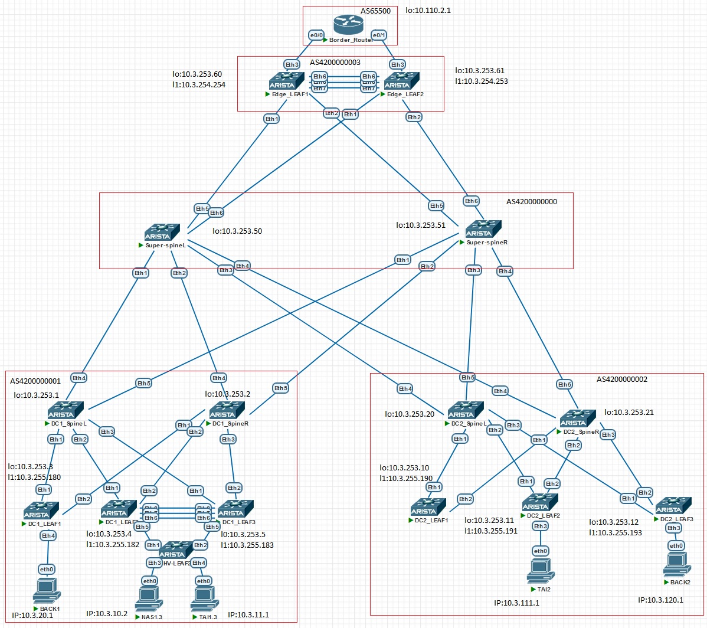
5 stage-clos

Slide 15

Вывод и планы по развитию
Выводы:
Проверив таблицы маршрутизации, VxLAN-туннели и ICMP-проверку клиентских устройств, убеждаемся, что распределённые центры обработки данных функционируют как внутри своих автономных систем, так и друг с другом, так и с удаленным центром обработки данных. Основной задачей проектной работы было закрепление материала, полученного из прошлых лекций и выполненных лабораторных работ, а также изучение работы и построение топологии MultiPod для распределенных ЦОД. После выполнения всех лабораторных и проектной работы планирую дальше изучать работу больших сетей, в частности углубиться в протокол BGP, IS-IS.

Slide 16
Спасибо за внимание!

